Slide 1

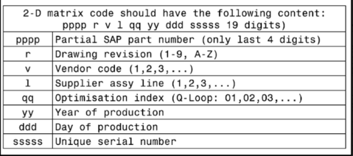

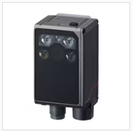
Design
Objective: Barcode Reader Integration for SmartBU EOL
Goal: improve traceability and reduce manual entry errors.
Scope: scan PCB barcode, validate format, link to test result.
Outcome: each DUT (Device Under Test) has unique digital test history.
Manual serial handling is error-prone.
Traceability audits require unit-level linkage.
Rework and failure analysis need fast record lookup.
Standardized scan flow improves line consistency.
https://www.keyence.com/products/barcode/barcode-readers/sr-x/models/sr-x100/
We are waiting for quotation..

Slide 2
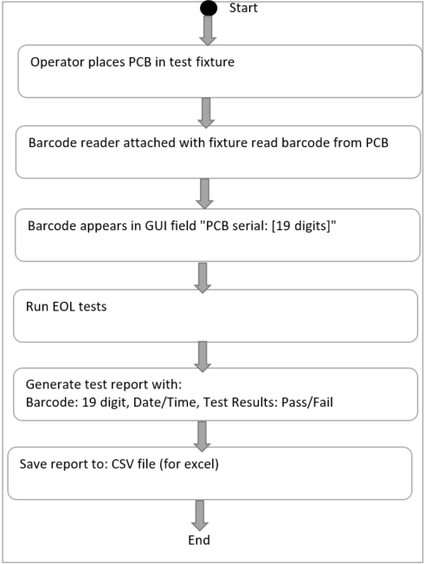
Design
1. Reader flow:
Operator places PCB in fixture.
Barcode scanner reads 2D code.
GUI validates barcode automatically.
EOL tests execute.
Report saved with barcode, timestamp, PASS/FAIL.
2. Control and Compliance:
Barcode format check (19-character standard).
Invalid barcode blocks test start.
Parsed barcode fields stored in report.
Derived PCB serial stored for quick tracking.
3. Management impact:
Better quality traceability.
Lower operator-induced data errors.
Faster root-cause analysis and containment.
Scalable approach for multi-station deployment.

